Slide 2
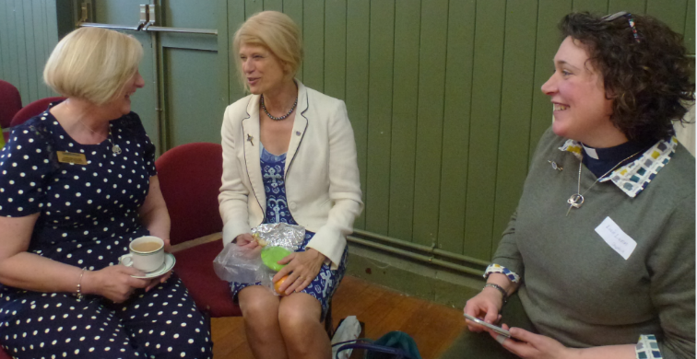
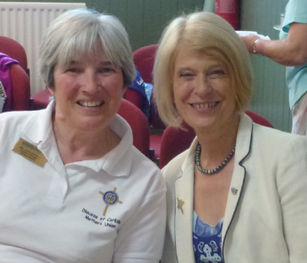
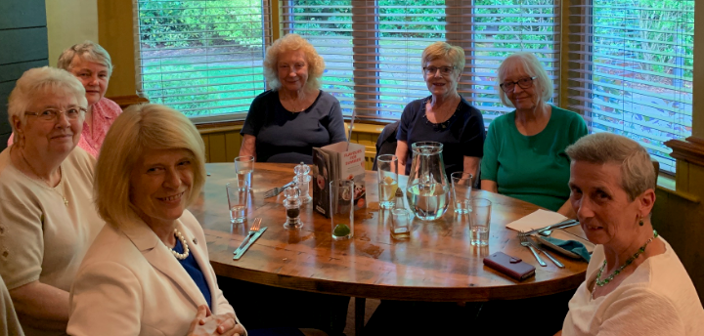
Thank You!

Slide 3
A New Dawn

Slide 4
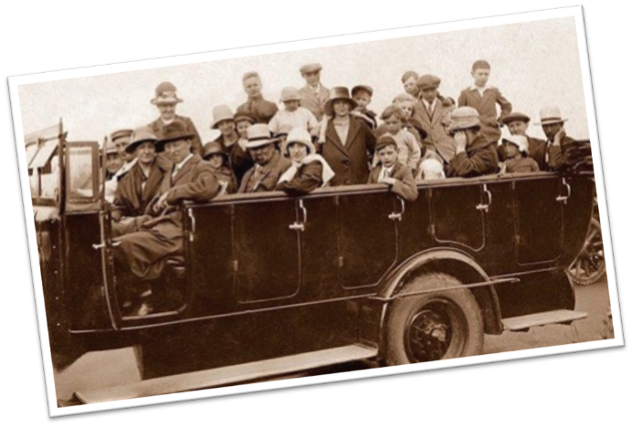

Getting there…
Progress is being made!

Slide 5

Communities of Interest
Governance (including Finance)
Communications
Faith
Fundraising
Membership
Policy
MUenterprises
Directory
Development

Slide 6
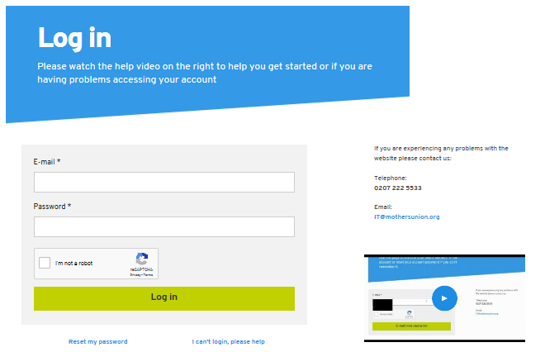
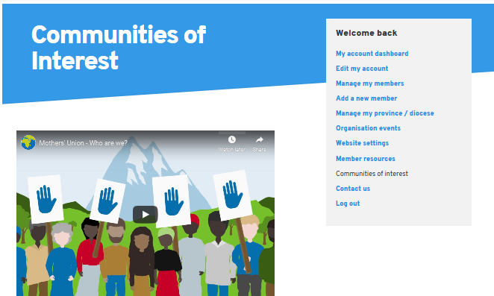
Communities of Interest

Slide 7
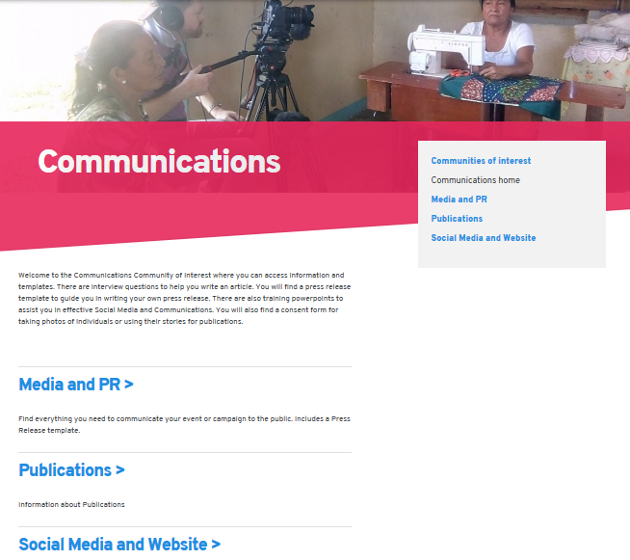
Communities of Interest
Communications

Slide 8
Working Groups….
Include…
GM Committee: Antonia Wilson, Emma Ham-Riche………
Metamorphosis Steering Group: Hilary Williams, Maureen Western, Alison Bennett, Elizabeth Groves, Sandra Goodey, Marianna Poliszcuk, Comfort Idowu-Fearon, Susan Baker
Parenting: Jackie Brocklebank, Felicity Hawke, Diane Clack, Heather Sayle, Karen Morris
MU Live: Susan Baker, Eric Swindells, Kay Warrington, Deborah Munday, June Houghton

Slide 9
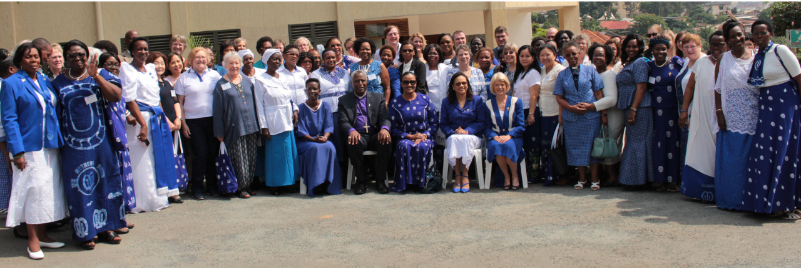
Worldwide Council
June 2019

Slide 10
Our Identity
Mothers’ Union is a global, women-led, volunteer movement. United in our diversity and living out our faith, we support individuals and families to transform their lives. Embedded in the Church and community, we have unprecedented reach that gives a voice to the stigmatized and vulnerable around the world.

Slide 11
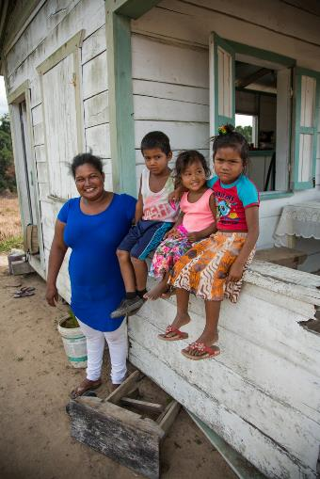
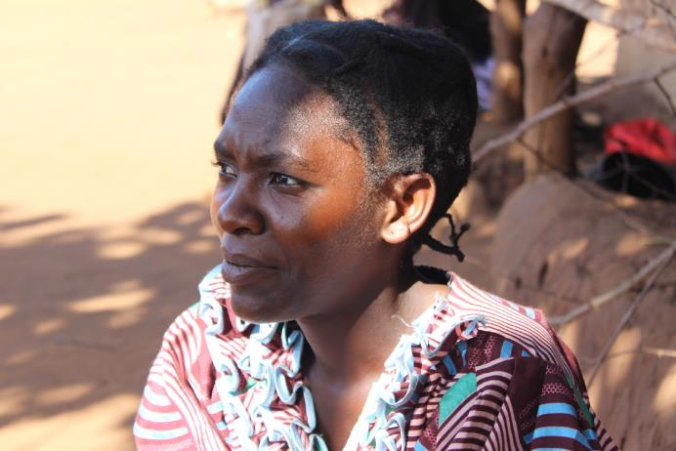
Who we serve
Focusing particularly on women and vulnerable children

Slide 12
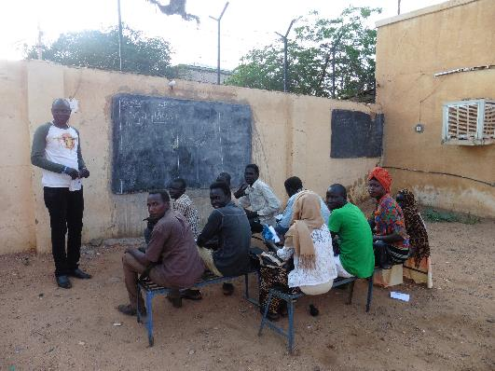
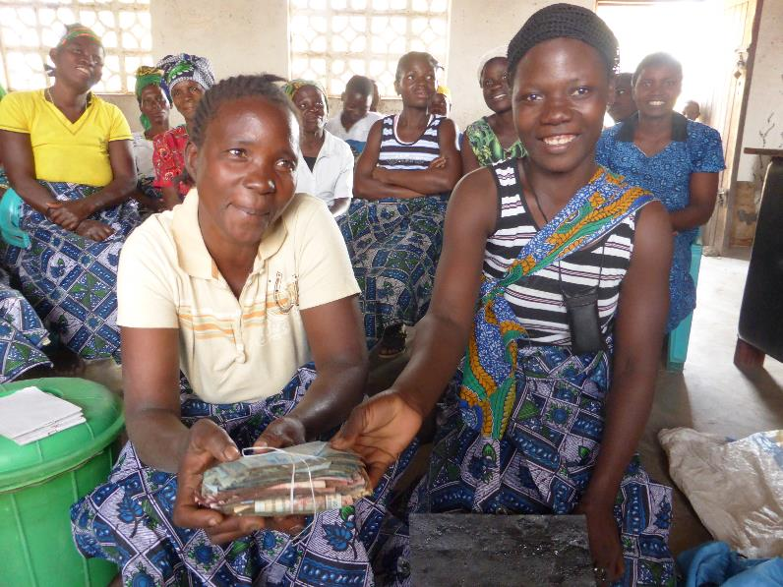
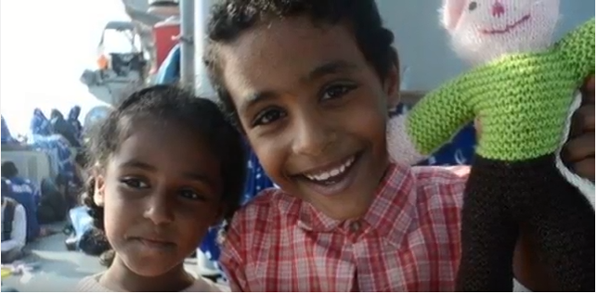
Changes in Lives
Building Hope and Confidence

Slide 13
Our Values
Inspire and guide us
being non-judgmental
loving and compassionate
persevering and bold

Slide 14
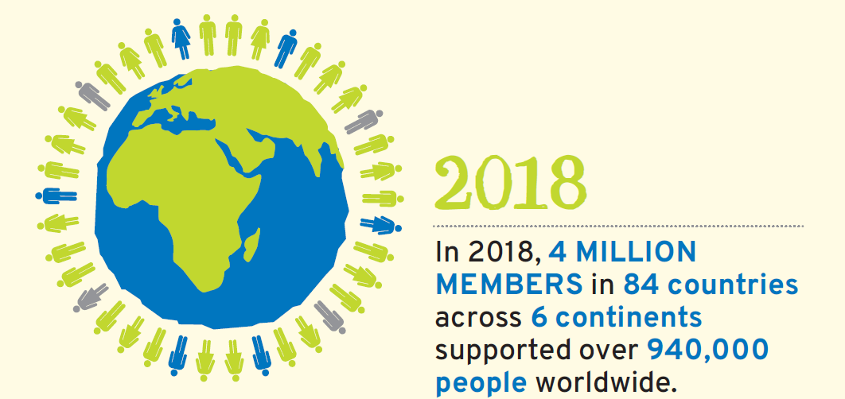
Local Action – Global Impact

Slide 15
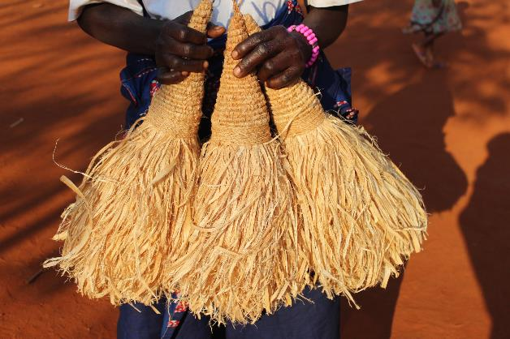
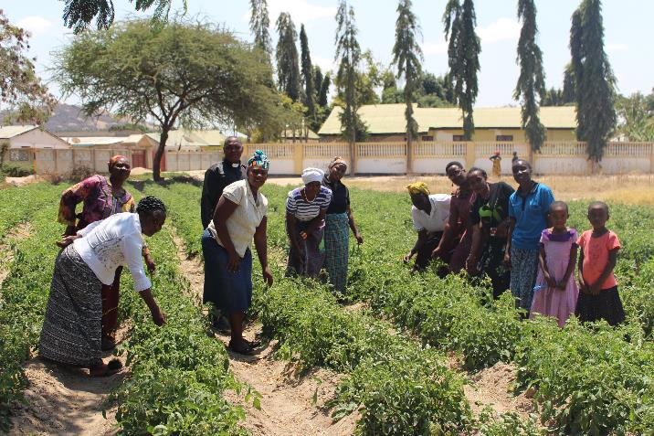
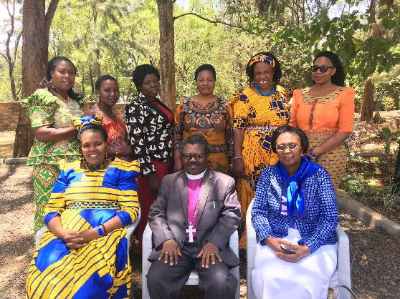
Building Self-reliance
Tanzania

Slide 16
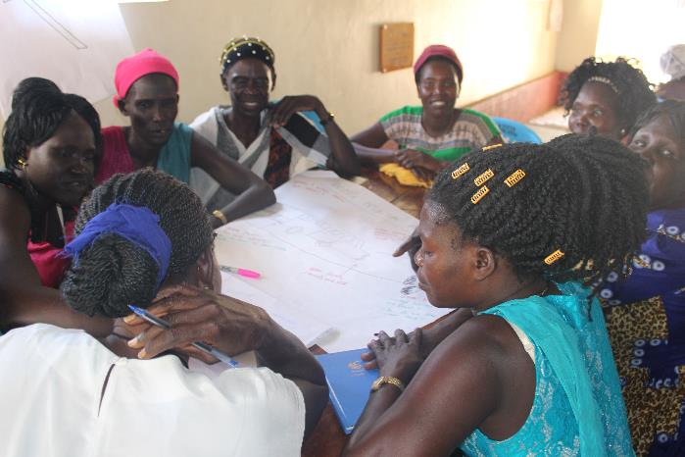
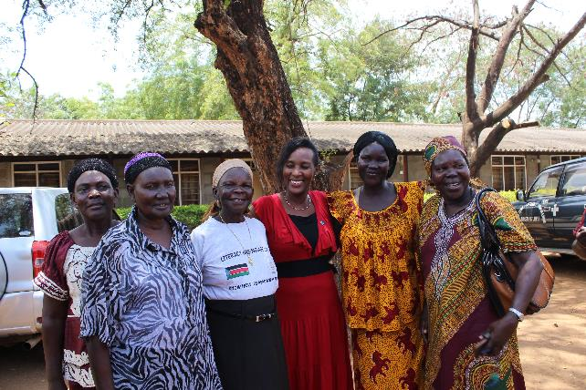
Creating Peace & Safety in
South Sudan

Slide 17
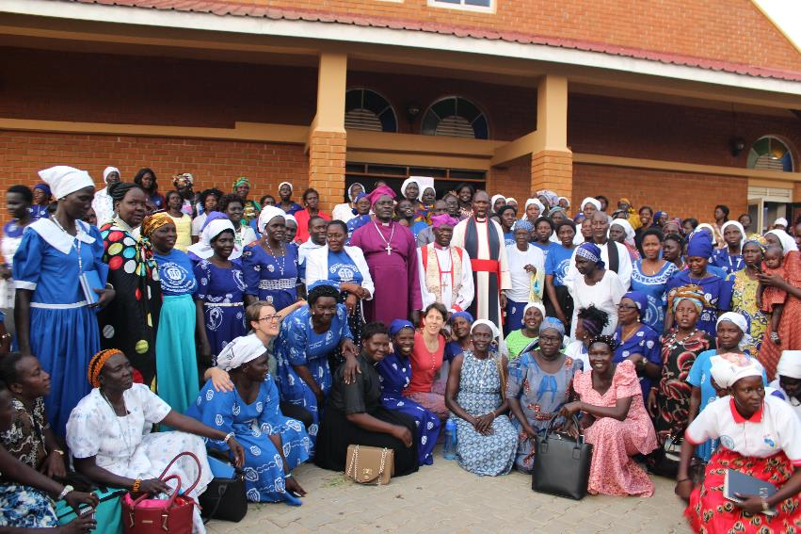
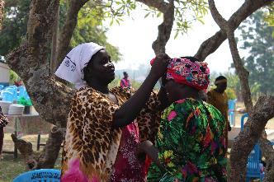
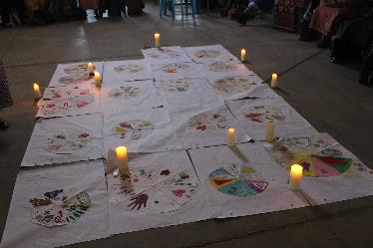
South Sudan
Leaders Healing Process

Slide 18
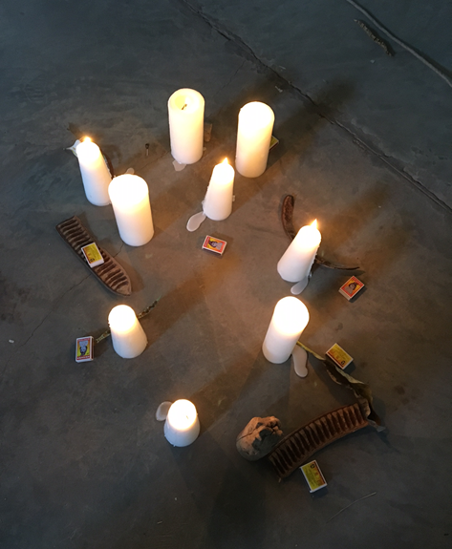
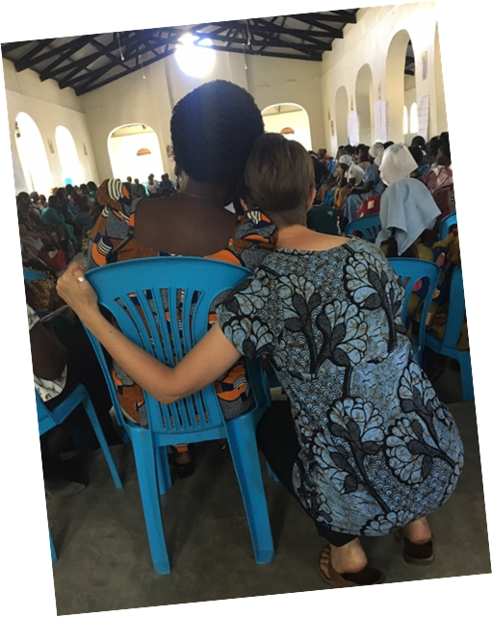
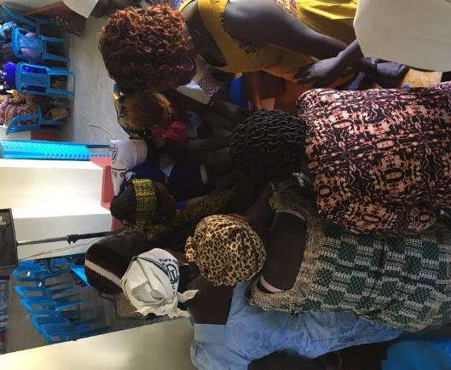
Laying down Burdens

Slide 19
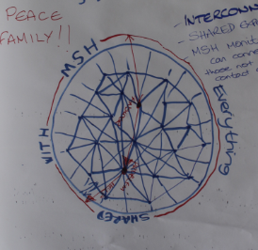
Connected World

Slide 20
Financial Summary
2018

Slide 21
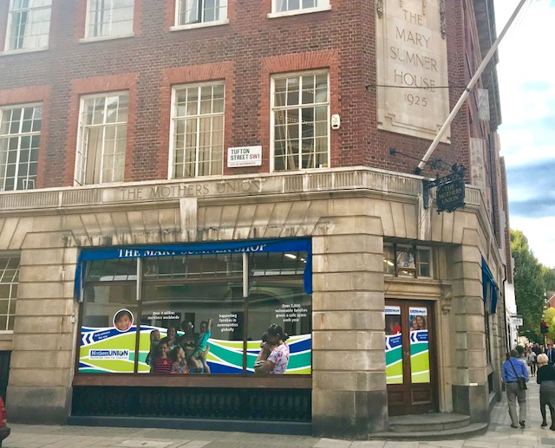
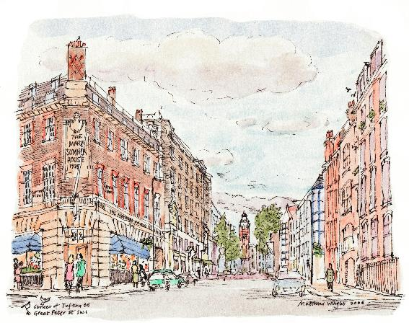
Mary Sumner House
Source of long-term income

Slide 22
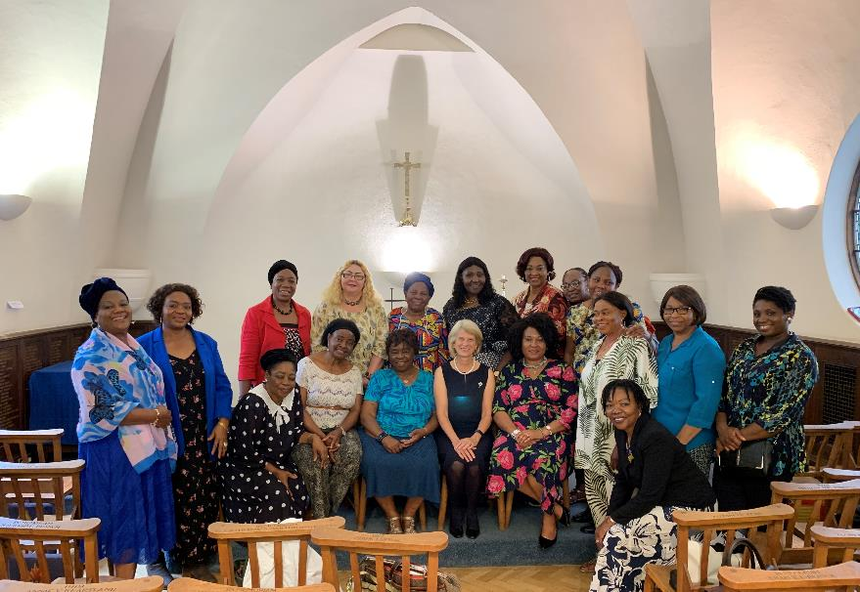
Mary Sumner House

Slide 23
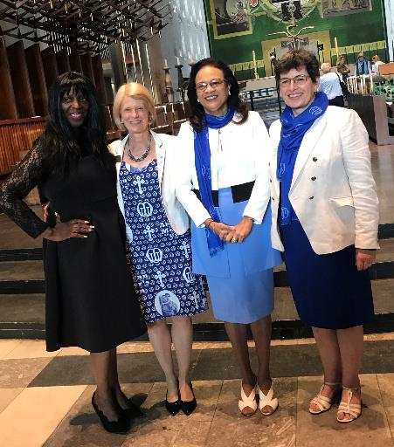
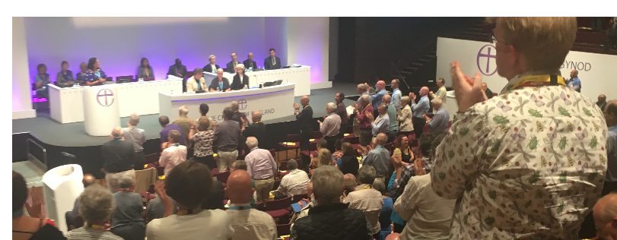

“Best kept secret in the Anglican Communion”
Not for long!

Slide 24
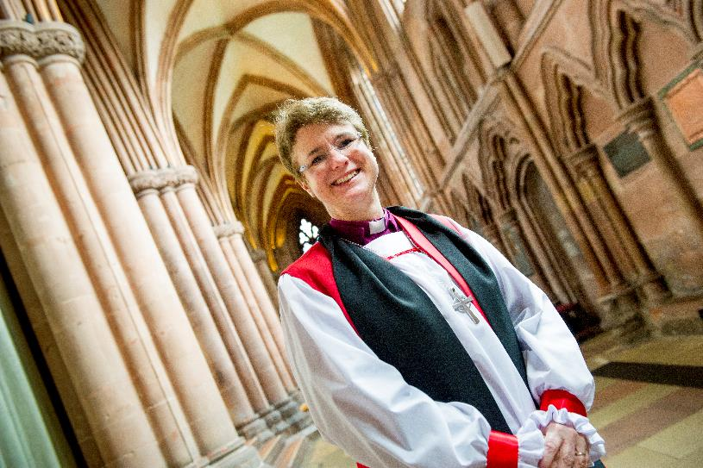
Our new Central Chaplain!
The Rev’d Dr Emma Ineson

