Slide 1
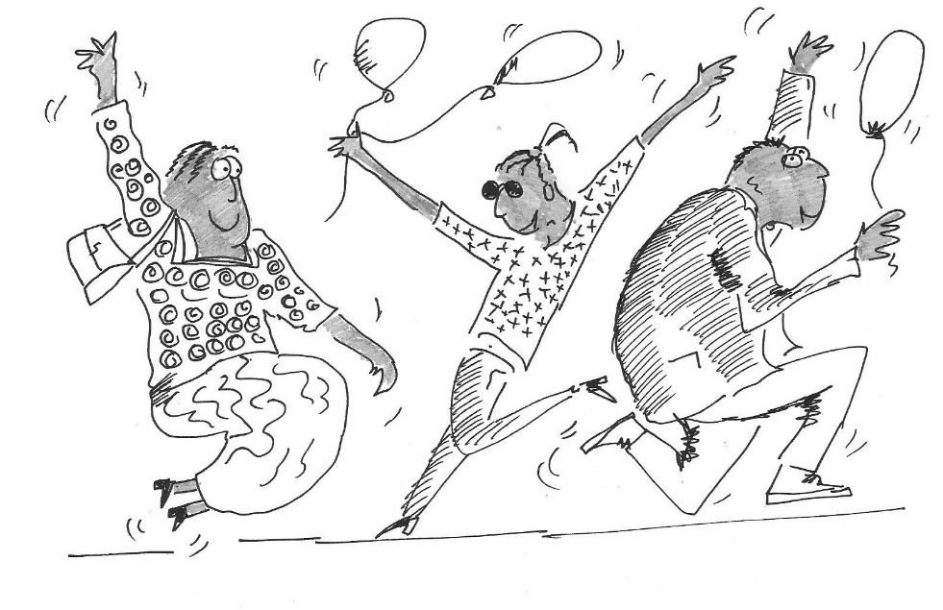
The Flying Metamoja
Notes:
The Flying Metamoja Game can be played as a stand alone game without the accompanying PowerPoint slides. However we hope that these slides will help transport participants in their imaginations to these communities. The last 2 pages of the game instructions can also be printed and given to participants as two real life examples.

Slide 2
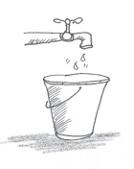
Stage 1 – The Project Approach
1
2
3

Slide 3
End of Stage 1 - Reflections
What happened? What do you see?
How do you feel? Is your community better or worse off than before?
Whose fault is it that the BLUES did not benefit from or participate in the projects?
In this game did the REDS or GREENS mistreat or discriminate against the BLUES?

Slide 4
Stage 2 – Church Mobilisation
“Before we used to only preach and teach the Word. But now, we are transforming the world around us, through a fish farming project, fattening chickens and goats, and growing spinach, aubergine, tomatoes, bananas and maize.”

Slide 5
Stage 2 – Church Mobilisation
“Before everyone felt that they were alone. But now that we have started CCMP, we are together. We share our problems together and pray with one another. When one of us is struggling we have something to offer that person.”

Slide 6
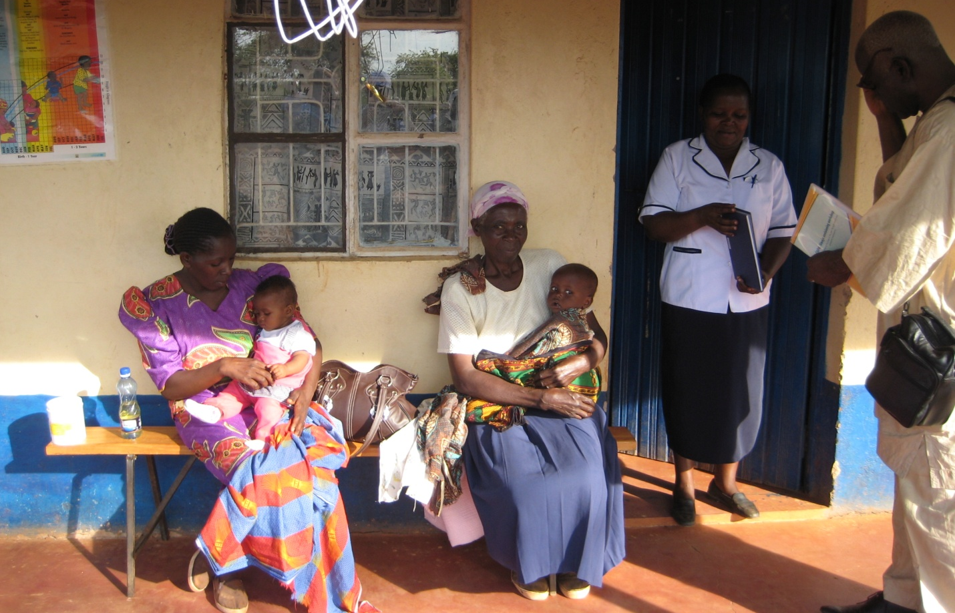
Stage 2 – Church and Community Mobilisation
Health Centre

Slide 7
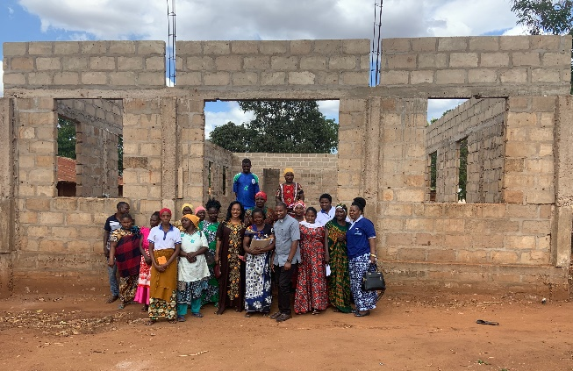
“We only win when we win together.”

Slide 8
End of Game - Reflections
What have you learnt from the game about how we work for change in our own local communities, or how we support projects in other countries?
Who might be the REDS, GREENS and BLUES in your community and how would you describe them?
How can we support the BLUES without excluding the REDS and GREENS?
What examples can you share of initiatives that are locally owned that engage with the whole person and bring lasting change?

